Slide 1
Transaction Processing Concept
Unit - 5

Slide 2
Topics to be covered
Introducing Transactions,
Processing a transaction and State of transaction,
ACID property of a transaction

Slide 3
Single-User Versus Multiuser system
Single-User:
At most one user at a time can use the system
Mostly restricted to personal computer system
Multi-User system:
Many users can use the system, and access the database concurrently
Eg. Airline reservation system, banking system, stock market, supper market etc…
In this system hundred and thousands of users are operating on the database by submitting transactions concurrently to the system.

Slide 4
Multiprogramming and Parallel Processing
Multiprogramming allows the operating system of the computer to execute multiple programs / processes at the same time
A single CPU can execute only one process at a time
Multiprogramming operating system executes some command from one process, then suspend the process and execute commands from next process…and so on
A process is resumed at the point where it was suspended, whenever it gets turn to use CPU again
If the computer has multiple CPUs, parallel processing of multiple processes is possible
Most of the systems have interleaved concurrency – i.e. primary resource accessed concurrently by interactive users or application programs, which are constantly retrieving information from / and modifying the DB.

Slide 5
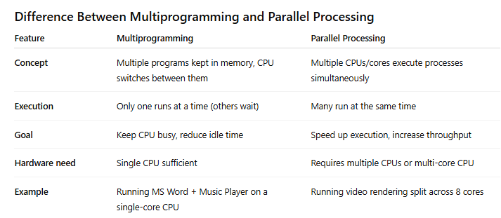
Multiprogramming and Parallel Processing

Slide 6
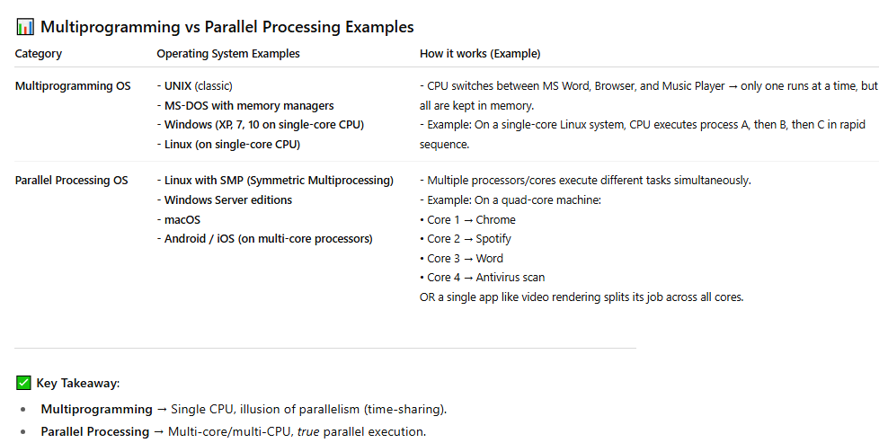
Multiprogramming and Parallel Processing

Slide 7
Transactions, Database Items, Read and Write Operations and DBMS Buffers
A transaction is an executing program that forms a logical unit of database processing.
A transaction includes one or more database access operations—these can include insertion, deletion, modification (update), or retrieval operations.
One way of specifying the transaction boundaries is by specifying explicit begin transaction and end transaction statements in an application program
A single application program may contain more than one transaction if it contains several transaction boundaries
If the database operations in a transaction do not update the database but only retrieve data, the transaction is called a read-only transaction; otherwise it is known as a read-write transaction.
A database is basically represented as a collection of named data items. The size of a data item is called its granularity.
A data item can be a database record, but it can also be a larger unit such as a whole disk block, or even a smaller unit such as an individual field (attribute) value of some record in the database

Slide 8
Access operations that a transaction can include are as follows:
read_item(X)
Reads a database item named X into a program variable. To simplify our notation, we assume that the program variable is also named X.
write_item(X).
Writes the value of program variable X into the database item named X

Slide 9
Executing a read_item(X) command includes the following steps:
1. Find the address of the disk block that contains item X.
2. Copy that disk block into a buffer in main memory (if that disk block is not already in some main memory buffer). The size of the buffer is the same as the disk block size.
3. Copy item X from the buffer to the program variable named X.
Executing a write_item(X) command includes the following steps:
1. Find the address of the disk block that contains item X.
2. Copy that disk block into a buffer in main memory (if that disk block is not already in some main memory buffer).
3. Copy item X from the program variable named X into its correct location in the buffer.
4. Store the updated disk block from the buffer back to disk (either immediately or at some later point in time).

Slide 10
Transaction and System Concept
A transaction is an atomic unit of work that should either be completed in its entirety or not done at all.
For recovery purposes, the system needs to keep track of when each transaction starts, terminates, and commits, or aborts
The recovery manager of the DBMS needs to keep track of the following operations:
BEGIN_TRANSACTION. This marks the beginning of transaction execution.
READ or WRITE. These specify read or write operations on the database items that are executed as part of a transaction.
END_TRANSACTION. This specifies that READ and WRITE transaction operations have ended and marks the end of transaction execution. However, at this point it may be necessary to check whether the changes introduced by the transaction can be permanently applied to the database (committed) or whether the transaction has to be aborted because it violates serializability or for some other reason.
COMMIT_TRANSACTION. This signals a successful end of the transaction so that any changes (updates) executed by the transaction can be safely committed to the database and will not be undone.
ROLLBACK (or ABORT). This signals that the transaction has ended unsuccessfully, so that any changes or effects that the transaction may have applied to the database must be undone.

Slide 11
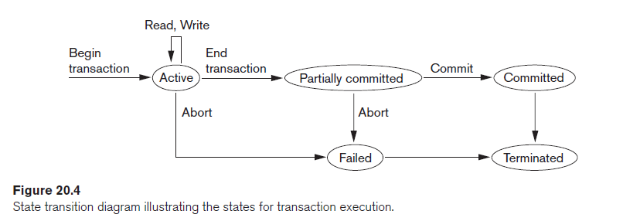

Slide 12
Desirable Properties of Transactions
The following are the ACID properties:
Atomicity. A transaction is an atomic unit of processing; it should either be performed in its entirety or not performed at all.
Consistency preservation. A transaction should be consistency preserving, meaning that if it is completely executed from beginning to end without interference from other transactions, it should take the database from one consistent state to another.
Isolation. A transaction should appear as though it is being executed in isolation from other transactions, even though many transactions are executing concurrently. That is, the execution of a transaction should not be interfered with by any other transactions executing concurrently.
Durability or permanency. The changes applied to the database by a committed transaction must persist in the database. These changes must not be lost because of any failure.

Slide 13
Schedules of Transaction
A schedule (or history) S of n transactions T1, T2, … , Tn is an ordering of the operations of the transactions.
Operations from different transactions can be interleaved in the schedule S.
For each transaction Ti that participates in the schedule S, the operations of Ti in S must appear in the same order in which they occur in Ti.
For the purpose of recovery and concurrency control, mainly read_item and write_item operations of the transactions, as well as the commit and abort operations are considered here.
A shorthand notation for describing a schedule uses the symbols b, r, w, e, c, and a for the operations begin_transaction, read_item, write_item, end_transaction, commit, and abort, respectively, and appends as a subscript the transaction id (transaction number) to each operation in the schedule

Slide 14
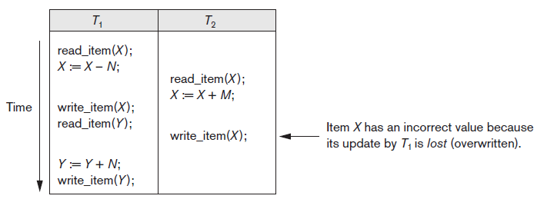
Example
Schedule for the following transaction can be written as:
S: r1(X); r2(X); w1(X); r1(Y); w2(X); w1(Y);
Highlighted operations are conflicting operations in the schedule – read-write conflict

Slide 15
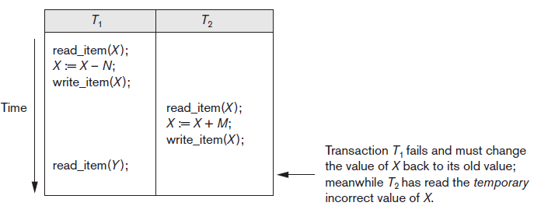
Example
Schedule for the following transaction can be written as:
S: r1(X); w1(X); r2(X); w2(X); r1(Y); a1;
Highlighted operations are conflicting operations in the schedule – write-write conflict

Slide 16
Conflicting Operations in a Schedule
Two operations in a schedule are said to conflict if they satisfy all three of the following conditions:
(1) they belong to different transactions;
(2) they access the same item X; and
(3) at least one of the operations is a write_item(X).
Two operations are conflicting if changing their order can result in a different outcome.

Slide 17
Complete Schedule
A schedule S of n transactions T1, T2, … , Tn is said to be a complete schedule if the following conditions hold:
1. The operations in S are exactly those operations in T1, T2, … , Tn, including a commit or abort operation as the last operation for each transaction in the schedule.
2. For any pair of operations from the same transaction Ti, their relative order of appearance in S is the same as their order of appearance in Ti.
3. For any two conflicting operations, one of the two must occur before the other in the schedule

Slide 18
Characterizing Schedules based on Recoverability
Once a transaction T is committed, it should never be necessary to roll back T.
This ensures that the durability property of transactions is not violated.
The schedules that theoretically meet this criterion are called recoverable schedules
A schedule where a committed transaction may have to be rolled back during recovery is called nonrecoverable schedules
and hence should not be permitted by the DBMS

Slide 19
The condition for a recoverable schedule is as follows
A schedule S is recoverable if no transaction T in S commits until all transactions T′ that have written some item X that T reads have committed.
A transaction T reads from transaction T′ in a schedule S if some item X is first written by T′ and later read by T.
In addition, T′ should not have been aborted before T reads item X, and there should be no transactions that write X after T′ writes it and before T reads it
Eg. Consider the schedule Sa’ given below, which is the same as schedule Sa except that two commit operations have been added to Sa:
Sa’ : r1(X); r2(X); w1(X); r1(Y); w2(X); c2; w1(Y); c1;
Sa’ is now called recoverable schedule, even though it suffers from the lost update problem

Slide 20
Example:
Consider the two (partial) schedules Sc and Sd that follow:
Sc: r1(X); w1(X); r2(X); r1(Y); w2(X); c2; a1;
Non Recoverable
Sd: r1(X); w1(X); r2(X); r1(Y); w2(X); w1(Y); c1; c2;
Recoverable
Se: r1(X); w1(X); r2(X); r1(Y); w2(X); w1(Y); a1; a2;
Recoverable with cascading rollback

Slide 21
Characterizing Schedules Based on Serializability
Suppose that two users—for example, two airline reservations agents—submit to the DBMS transactions T1 and T2 at approximately the same time.
If no interleaving of operations is permitted, there are only two possible outcomes:
1. Execute all the operations of transaction T1 (in sequence) followed by all the operations of transaction T2 (in sequence).
2. Execute all the operations of transaction T2 (in sequence) followed by all the operations of transaction T1 (in sequence).
These two schedules—called serial schedules

Slide 22
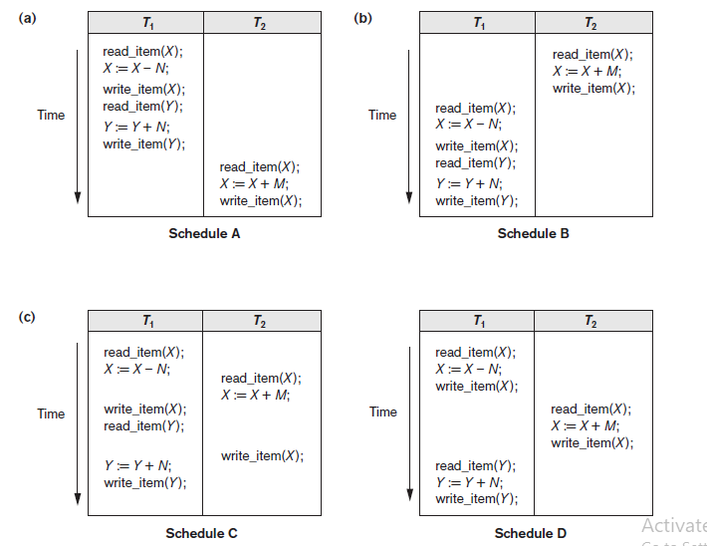
Schedule A and B are serial schedules
Schedule C is Non-Serializable Schedule
Schedule D is called as serializable schedule

Slide 23
Practical
Oracle Transactions: A series of one or more SQL statements that are logically related or a series of operations performed on oracle table data is termed as transaction.
Transaction is a group of events that occur between any of the following events:
Connection to Oracle
Disconnecting from oracle
Committing changes to the database table
Rollback

Slide 24
Using Commit
A commit ends the current transaction and makes any changes permanent, made during transaction
Syntax:
COMMIT;

Slide 25
Rollback
A rollback does exactly opposite to Commit.
It ends the transaction but undoes any changes made during the transaction
All transaction locks acquired on tables are released
Syntax:
ROLLBACK [WORK] [TO [SAVEPOINT] <SavePoint Name>];

Slide 26
Creating SavePoint
Save point marks and saves the current point in the processing of a transaction.
When the SavePoint is used with the rollback statement, part of a transaction can be undone
An active SavePoint is one that is specified since the last COMMIT or ROLLBACK
Syntax:
SAVEPOINT <SavePoint Name>

